Slide 1

Lesson 6: Generics. Collections Framework

Slide 2

Lecture plan/goals
1. Generics
2. Equals and HashCode
3. Collection framework

Slide 3
Life before generics
List yourHead = new ArrayList(); yourHead.add("OOP Knowledge"); yourHead.add("Collections Knowledge"); yourHead.add(Integer.valueOf(2)); // OK for (Object obj : yourHead) { // type casting leading to ClassCastException at runtime String str = (String) obj; System.out.println(obj + " -- OK"); }
We got a Runtime error:

Slide 4
Life with generics
List<String> yourHead = new ArrayList<>(); yourHead.add("OOP Knowledge"); yourHead.add("Collections Knowledge"); yourHead.add(Integer.valueOf(2)); // It will leading to compile error for (Object obj : yourHead) {
String str = (String) obj; System.out.println(obj + " -- OK"); } }
Compile error:

Slide 5
Nongeneric class example
Class realization:
Class usage:
public class Cafe { private final Object order; public Cafe(Object order) { this.order = order; } public Object getOrder() { return order; } }
class Water { } class Pasta { } class Pizza { } public class ApplicationStarter { public static void main(String[] args) { Cafe cafe = new Cafe(new Pizza()); Pasta pasta = (Pasta) cafe.getOrder(); } }
It also leading us a runtime ClassCastException

Slide 6
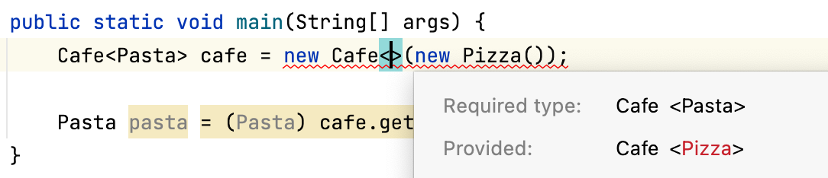
How to make it type safe:
public class Cafe<E> { //declaring a type parameter E private final E order; // variable of E type public Cafe(E order) { // method parameter with E type this.order = order; } public E getOrder() { //returns an object of type E return order; } }

Slide 7
Also you could create a generic method:
public <E> void getOrderWithCheck(E order) { System.out.println(getCheck() + order.toString()); } private String getCheck() { return "--------- YOUR TOTAL IS: "; }
You can define multiply generics:
public <E, T> void getOrderWithCheck(E order, T orderType) { String orderHeader = wrapOrderType(orderType); System.out.println(getCheck() + order.toString()); } private <T> String wrapOrderType(T orderType) { if (orderType instanceof GroupOrder) { return "Thanks for the group order, you will receive a 20% discount"; } else { return "Thanks for the order!"; } }

Slide 8
With generics we can we can specify that a method accepts a type and all its subclasses (upper bound):
package edu.geekhub.homework; public class Order { public void printOrder(){} }
public <E extends Order> void getOrderWithCheck(E order) {//lower-bounded generic printCheck(); order.printOrder(); }
private void printCheck() { }

Slide 9
Multiply Bounderies example
class Pizza { public void printName(){} }
interface Pasta { boolean isBalonieze(); }
public <E extends Pizza & Pasta> void getOrderWithCheck(E product) { printCheck(); product.printName(); product.isBalonieze(); }

Slide 10
Using Wildcards
The wildcard ? represents an unknown type. You can use it to declare the type of a parameter; a local, instance, or static variable; and return value of generic types. But you can’t use it as a type argument to invoke a generic method, create a generic class instance, or for a supertype.
class Pizza { } public class ApplicationStarter { public static void main(String[] args) { List<?> orders = new ArrayList<>(); orders.add(new Pizza()); // compile error } }
The add() method takes arguments of type E, the element type of the collection. When the actual type parameter is ?, it stands for some unknown type. Any parameter we pass to add would have to be a subtype of this unknown type. Since we don't know what type that is, we cannot pass anything in. The sole exception is null, which is a member of every type.

Slide 11
Bounded wildcards
You can restrict use of arguments to a type and its subtypes by using <? extends Type>, where Type refers to a class, interface, or enum. In upper-bounded wildcards, the keyword extends is used for both a class and an interface.
public class ApplicationStarter { public static void main(String[] args) { List<? extends Order> orders = new ArrayList<>(); orders.add(new Pizza()); // compile error } }
public class ApplicationStarter { public static void main(String[] args) { List<? super Order> orders = new ArrayList<>(); orders.add(new Pizza()); // compile error } }

Slide 12
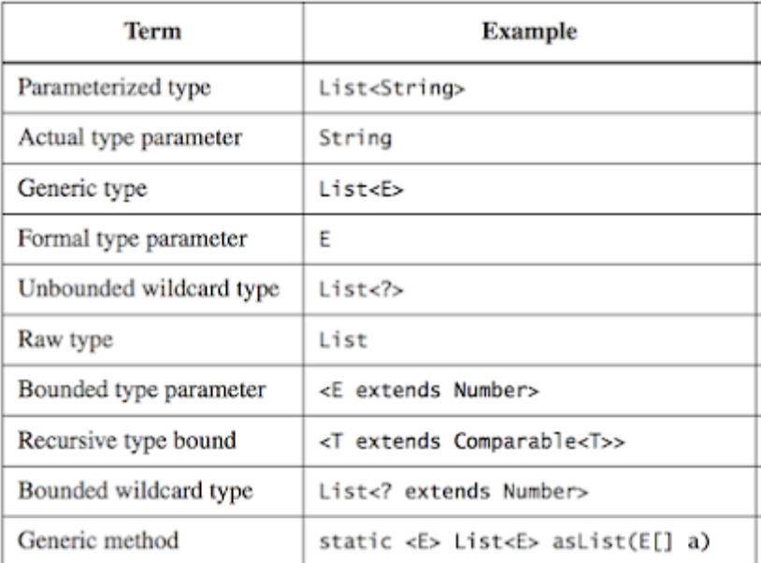

Slide 13
Naming Conventions For Generics
A type parameter can be named anything you want. The convention is to use single uppercase letters to make it obvious that they aren’t real class names. The following are common letters to use:
E for an element
K for a map key
V for a map value
N for a number
T for a generic data type
S, U, V, and so forth for multiple generic types

Slide 14
equals() and hashCode()

Slide 15
Method equals()
Method equals() is used to determine whether two objects of a class should be considered equal or not.
The default implementation of method equals() in class Object compares the object references and returns true if both reference variables refer to the same object, or false otherwise. In essence, it only returns true if an object is compared to itself.
public boolean equals(Object obj) {
return (this == obj);
}

Slide 16
The Need To Override Method equals()
You need to override method equals() for objects that you wish to equate logically, which normally depends on the state of an object (that is, the value of its instance variables).
The goal of overriding method equals() is to check for equality of the objects, not to check for the same variable references.
For example, class String overrides method equals() to check whether two String objects define the exact same sequence of characters:
String name1 = new String("John Doe");
String name2 = new String("John Doe");
System.out.println(name1.equals(name2));

Slide 17
Rules For Overriding Method equals()
1. It’s reflexive. For any non-null reference value x, x.equals(x) should return true.
2. It’s symmetric. For any non-null reference values x and y, x.equals(y) should return true if and only if y.equals(x) returns true.
3. It’s transitive. For any non-null reference values x, y, and z, if x.equals(y) returns true and y.equals(z) returns true, then x.equals(z) should return true.
4. It’s consistent. For any non-null reference values x and y, multiple invocations of x.equals(y) consistently return true or consistently return false, provided no information used in equals comparisons on the objects is modified.
5. For any non-null reference value x, x.equals(null) should return false.

Slide 18
Method hashCode()
A hash function is any function that can be used to map data of arbitrary size to data of fixed size. The values returned by a hash function are called hash values, hash codes, hash sums, or simply hashes.
Method hashCode() returns a hash-code value for an object, which is used to efficiently store and retrieve values in collection classes that use hashing algorithms, such as HashMap.

Slide 19
The hashCode() Contract
1. Whenever it is invoked on the same object more than once during an execution of an application, the hashCode method must consistently return the same integer, provided no information used in equals comparisons on the object is modified.
2. If two objects are equal according to the equals(Object) method, then calling the hashCode method on each of the two objects must produce the same integer result.
3. It is not required that if two objects are unequal according to the equals(Object) method, then calling the hashCode method on each of the two objects must produce distinct integer results.

Slide 20
Collections framework

Slide 21
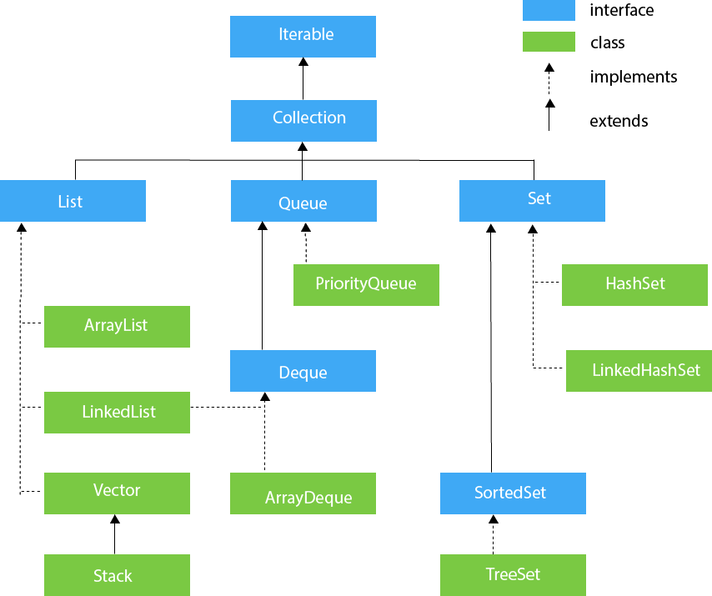

Slide 22
Collection interface’s methods:
add(E Element) : Boolean, inserts a new element. remove(E Element) : Boolean, removes an element from the collection. isEmpty() : Boolean, returns true if the collection has no elements. size() : Returns how many elements we have stored in the collection. clear(): void, removes all elements from the collection. contains(E Element): Boolean, verifies if some element is stored in the collection.

Slide 23
Lists overview
Use List if you need an ordered collection allowing duplicate elements. You have 2 different implementations of this interface:
ArrayList: A resizable array, every time it reaches the limit, automatically doubles its size. Good performance when looking over the elements (even faster than adding or removing).
LinkedList: Implements List and Queue. A good option when you need add or remove elements constantly, slower when you need to lookup over all the elements. LinkedList is often used as a Queue instead of a common List.

Slide 24
Set overview
Similar to List, but it does not accept duplicated elements and does not keep a defined order. We can find the following implementations:
HashSet: Uses a HashTable for storing objects. It means, it uses the hashCode() method from the stored objects to retrieve them more efficiently. Use this implementation if you don’t mind the order of stored elements.
TreeSet: Store objects ordered in a tree structure. The main benefit is all elements are always ordered, but it has a performance cost when you need to add more elements because it needs first to find the right position (keeping the order).

Slide 25
Map overview
Map is outside the Collection interface, so you won’t see the same methods as the previous interfaces. Map is a special collection, used when you need to store elements in a key: value format, for example, you need to save your contact numbers. You will identify each number by the name it has:
name -> key
number -> value
Like the other interfaces, Map has its own implementations:
HashMap: Store the keys in a HashTable, do not order the elements. If you need the elements ordered, you can use a LinkedHashMap instead.
TreeMap: Maintains all elements sorted by key.

Slide 26
The Map interface define the following methods:
clear(): Removes all keys and values from the map.
isEmpty(): Returns if the map is empty.
int size(): Returns the number of entries (key/value pairs) in the map.
V get(Object key): Returns the value mapped by key or null if none is mapped.
V put(K key, V value): Adds or replaces key/value pair. Returns previous value or null.
V remove(Object key): Removes and returns value mapped to a key. Returns null if none.
containsKey(Object key): Returns whether the key is on map.
containsValue(Object): Returns the value in the map.
Set<K> keySet() : Returns set of all keys.
Collection<V> values(): Returns Collection of all values.

Slide 27
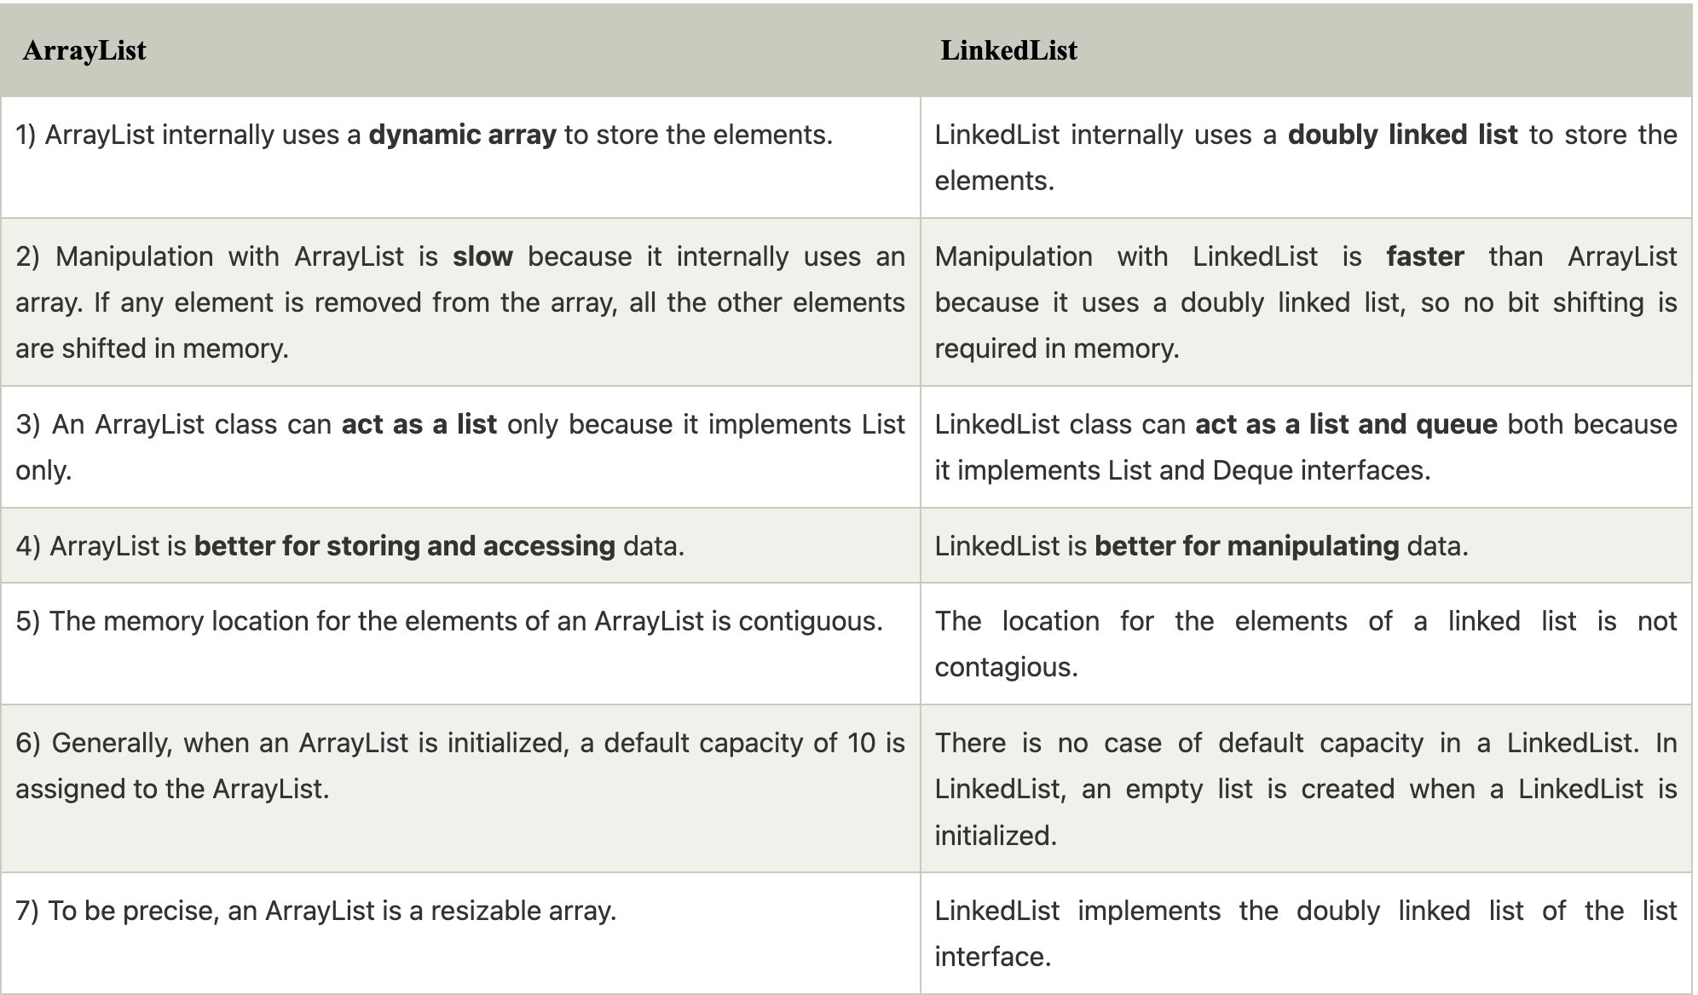
Question from Java interviews: ArrayList vs LinkedList

Slide 28
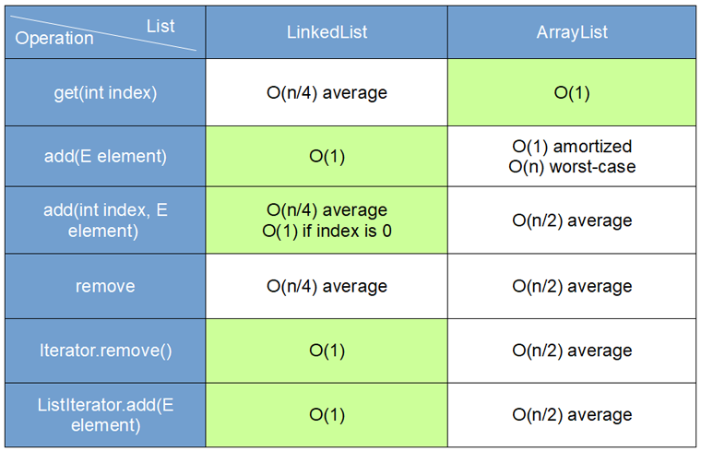
Big O notation
Asymptotic notations are used to represent the complexity or running time of an algorithm. It is a technique of defining the upper and lower limits of the run-time performance of an algorithm. We can analyze the runtime performance of an algorithm with the help of asymptotic notations.

Slide 29
Iterator VS Iterable
interface Iterator<E> { boolean hasNext(); E next(); void remove();
void forEachRemaining(Consumer<? super E> action); }
interface Iterable<T> { Iterator iterator();
void forEach(Consumer<? super T> action)
Spliterator<T> spliterator()
}

Slide 30
Sort and Comparable
class Animal { String name; Integer strength; // constructor
}
List<Animal> animals = new ArrayList<>(); animals.add(new Animal("cat", 3)); animals.add(new Animal("dog", 2)); animals.add(new Animal("elephant", 45));
Collections.sort(animals); // fails to compile
for (Animal animal : animals) { println(animal.getname()); }

Slide 31
Interface comparable
public static <T extends Comparable<? super T>> void sort(List<T> list) { list.sort(null); }
public interface Comparable<T> { int compareTo(T o); }
Zero is returned when the current object is equal to the argument to compareTo().
A number less than zero is returned when the current object is smaller than the argument to compareTo().
A number greater than zero is returned when the current object is larger than the argument to compareTo()

Slide 32
Copmarable Example:
class Animal implements Comparable<Animal> { String name; Integer strength; // constructor @Override public int compareTo(Animal other){ return name.compareTo(other.name); } }
List<Animal> animals = new ArrayList<>(); animals.add(new Animal("cat", 3)); animals.add(new Animal("dog", 2)); animals.add(new Animal("elephant", 45));
Collections.sort(animals);
animals.forEach(System.out::print); // cat dog elephant

Slide 33
Comparator
public interface Comparator<T> { int compare(T o1, T o2); }
Zero is returned when the arguments of compare() methods are equal.
A number less than zero is returned when the first argument is smaller than the second argument to compare()
A number greater than zero is returned when the first argument is greater than the second argument to compare()

Slide 34
Comparator Example:
class Animal { String name; Integer strength; // constructor }
Comparator<Animal> animalComparatorByStrength = new Comparator<>() { @Override public int compare(Animal o1, Animal o2) { return o1.strength.compareTo(o2.strength); } }
List<Animal> animals = new ArrayList<>(); animals.add(new Animal("cat", 3)); animals.add(new Animal("dog", 2)); animals.add(new Animal("elephant", 45));
Collections.sort(animals, animalComparatorByStrength);
animals.forEach(System.out::print); // dog cat elephant

Slide 35
HomeWork
1. Implement your own Iterable and Iterator that will iterate only even index. Use a snippet from the repository and add the missing code. Write a test to check if it works fine. 2. Implement ToDoList based on the code snippet and provided interface, some of the methods are implemented, and some are half-implemented. Complete the code and write tests for that.

Slide 36
Thanks!
Find us in Slack:
@Bohdan Cherniak
@Vladyslav Nikolenko
@Volodymyr Vedula

